Slide 1
MKT10723 – Marketing Communications
Topic 3 – Building brand relationships Part II

Slide 2
Lecture outline
What are brand touch points?
The communication process and how it fits with marketing communications
Building relationships and brand loyalty

Slide 3
Brand touch points
Everything, every person, and every message that touches a customer communicates something positive or negative about the organisation
Touch point
Touch point
customer initiated,
unexpected,
intrinsic, company created
Touch point
Touch point

Slide 4
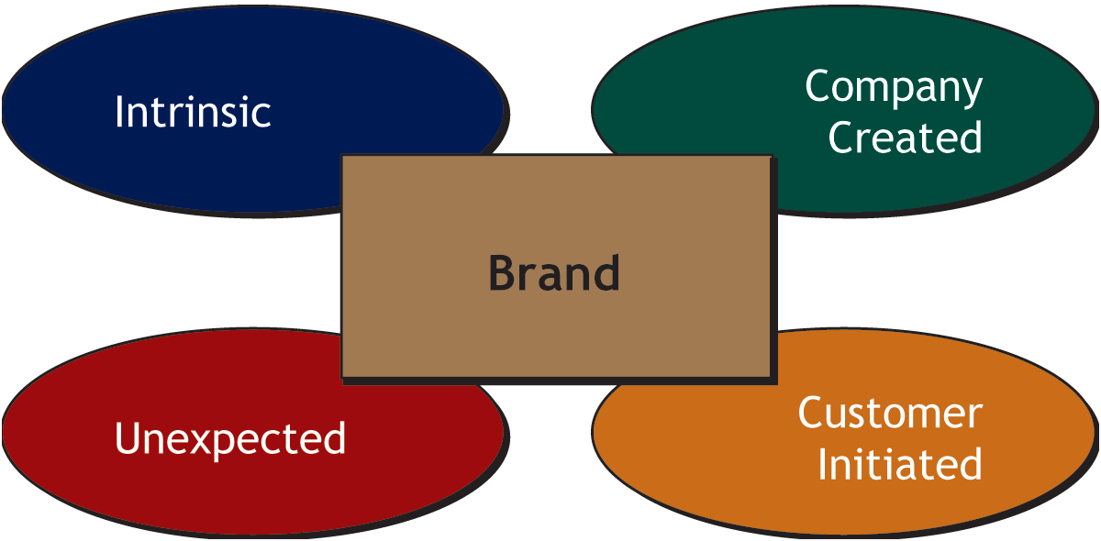
IMC Brand Touch points

Slide 5
Company created touch points
It is a high control, low impact touch point
Planned marketing communication messages from the organisation, such as packaging, advertising and so on.

Slide 6
How Does Communication Work?
Communication: Creating and sending a message to an individual or organization

Slide 7
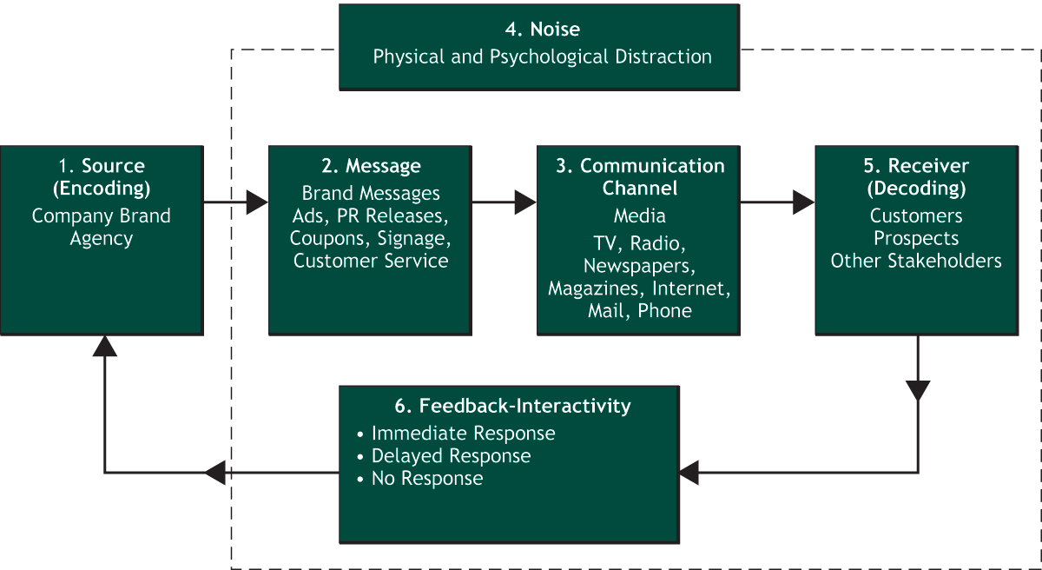
How Brand Communication Works

Slide 8
Types and Sources of Noise

Slide 9
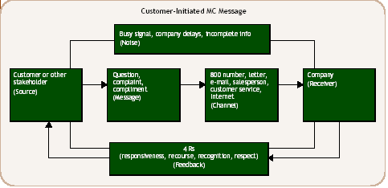
Table 3-3 Customer Initiated MC Message

Slide 10
Intrinsic touch point
High control, low impact
Interactions when buying or using the brand, in the forms of the other marketing strategies:
Price
Product
Distribution
Physical evidence
Process
People

Slide 11
Unexpected touch points
It is a low control, high impact touch point
Unanticipated references or information that a customer receives that is beyond the control of the organisation.

Slide 12
Customer initiated touch point
Relatively low control, high impact
When a customer initiates contact with the organisation for example a complaint, compliment, online communication

Slide 13
Brand relationships and brand loyalty
Brand loyalty
Brand communities

