Slide 1
MKT10723 – Marketing Communications
Topic 2 – Building brand relationships

Slide 2
Lecture outline
What is a brand?
How are brands created?
How do you create a successful brand?

Slide 3
What Does “Brand” Mean?
Brand: A perception resulting from experiences with, and information about, a company or line of products
Branding: The process of creating a brand image that engages the hearts and minds of customers

Slide 4
What Does “Brand” Mean?
Differentiates a Product From Its Competitors
Differentiates a Product From Its Competitors
What a Brand Does
Makes a Promise to Consumers
Makes a Promise to Consumers
Serves As the Driving, Unifying Force Directing All Functional Areas, Including IMC

Slide 5
Think about how powerful a brand is…
Perceived risks associated with consumer behaviour:
Financial
Social
Time

Slide 6
How are brands created?
Determining the Desired Brand Position
1. Determining the Desired Brand Position
3 Key Steps
Developing Brand Identification
2. Developing Brand Identification
3. Creating Brand Image

Slide 7
1. Developing the brand positioning
Determine the positioning strategy, based on one of several variables:
Price/quality,
Use
product class
User
Competitor
cultural symbols
Attributes and benefits.

Slide 8
2. Develop the brand identity
Using brand elements:
Brand names
Brand symbols:
Font
Jingles
Packaging
Symbols

Slide 9
Brands are often represented by logos
Logos: Distinctive graphic designs used to communicate a product, company, or organization identity

Slide 10
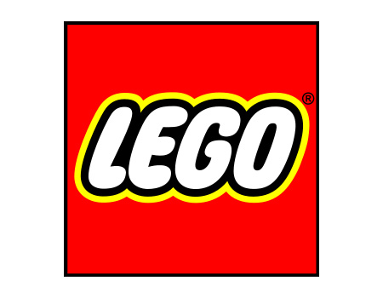

Slide 14
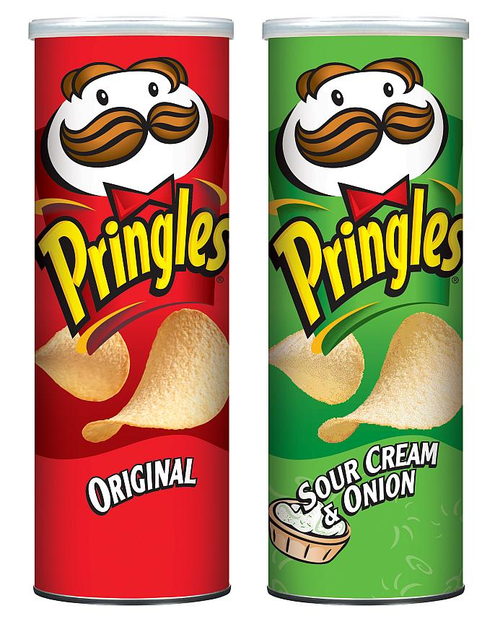

Slide 15
3. Create the brand image
Engaging the consumer completely using marketing communications

Slide 16
How Are Brands Created?
Determining the Desired Brand Position
1. Determining the Desired Brand Position
3 Key Steps
Developing Brand Identification
2. Developing Brand Identification
3. Creating Brand Image

Slide 17
What makes a successful brand?
Needs to differentiated
Positioned on quality and value
Innovative to changing needs
Full commitment from staff
Consistent and long term communications

Slide 18
What Is Brand Equity and How Is It Created?
Brand equity: The intangible value of a company beyond its physical net assets
Broadening distribution
Broadening distribution
4 Ways of Leveraging
Brand extensions
Brand extensions
Co-branding
Co-branding
Brand licensing

Slide 19
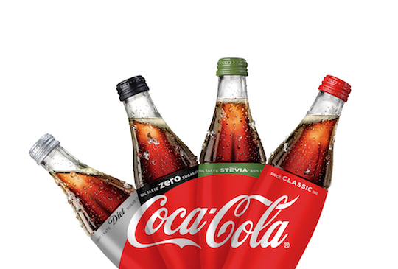

Slide 20
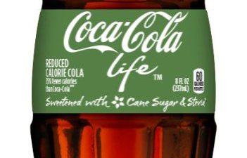

Slide 21
Conclusion
What is a brand?
How are brands created?
How do you create a successful brand?

